Slide 1
Accounting Information Systems
PRESENTED BY: EDGAR OTIENO
Lecture 8
Enterprise Resource Planning Systems
Notes:
31

Slide 2
Objectives for Lecture 8
Functionality and key elements of ERP systems
ERP configurations--servers, databases, and bolt-on software
Data warehousing as a strategic tool and issues related to the design, maintenance, and operation of a data warehouse
Risks associated with ERP implementation
Key considerations related to ERP implementation
Internal control and auditing implications of ERPs
Compare the goals of current enterprise resource planning (ERP) systems with those of the REA enterprise ontology
Discuss strengths and weaknesses of the REA enterprise ontology as a foundation for meeting intra-enterprise and inter-enterprise information integration needs
The leading ERP products and their distinguishing features
Notes:
31

Slide 3
Problems with Non-ERP Systems
In-house design limits connectivity outside the company
Tendency toward separate IS’s within firm
  lack of integration limits communication within the company
Strategic decision-making not supported
Long-term maintenance costs high
Limits ability to engage in process reengineering

Slide 4
Traditional IS Model: Closed Database Architecture
Similar in concept to flat-file approach
  data remains the property of the application
  fragmentation limits communications
Existence of numerous distinct and independent databases
  redundancy and anomaly problems
Paper-based
  requires multiple entry of data
  status of information unknown at key points

Slide 5
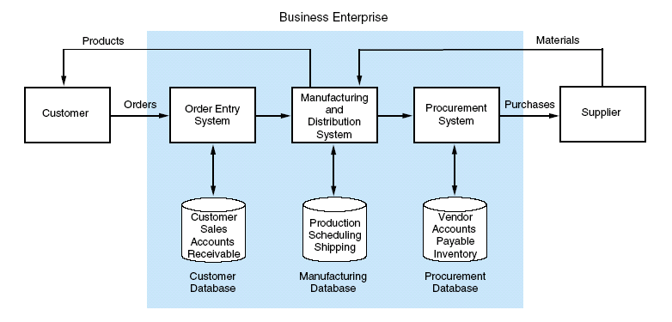
Traditional IS Model: Closed Database Architecture …

Slide 6
What is an ERP System?
Multi-module application software that helps a company manage the important parts of its business in an integrated fashion.
Key features include:
  smooth and seamless flow of information across organizational boundaries
  standardized environment with shared database independent of applications and integrated applications

Slide 7
Intra-Enterprise Systems: ERP and the REA Enterprise Ontology
Enterprise Resource Planning (ERP) Systems
  Groups of software applications integrated to form enterprise-wide information systems
    SAP, Peoplesoft, and Oracle Applications are the top three ERP vendors
  Began as back-office applications
    Seen and used only by people within enterprises
  Bolt-on applications have allowed expansion to front office use
    Bolt-on applications are software programs that can be added to existing ERP applications
    Front-office systems are seen and interacted with by external partners such as customers and suppliers

Slide 8
Goals and Methods of ERP Software and the REA Enterprise Ontology
Database Orientation
  Data must be stored at their most primitive levels, at least for a defined time period
  Data must be stored only once, in a way that all authorized decision makers can access the data
  Data must be stored to allow retrieval in various formats as needed for different purposes
REA mandates database orientation
Some ERP systems meet database orientation
  Some store the same information multiple places and some do not include all links needed to retrieve information in all needed formats
    Single Source ERP are more likely than Best-of-Breed ERP systems to meet database orientation

Slide 9
Goals and Methods of ERP Software and the REA Enterprise Ontology …
Semantic Orientation
  Requires objects in the system’s conceptual model to correspond as closely as possible to objects in the underlying reality
  Precludes use of artificial constructs such as debits, credits, and accounts as base objects in the enterprise system
  REA mandates semantic orientation
  ERP systems do not require semantic orientation
    Evidenced by use of accounting artifacts as base objects

Slide 10
Goals and Methods of ERP Software and the REA Enterprise Ontology …
Structuring Orientation
  Demands the use of a pattern as a foundation for the enterprise system
  REA mandates use of pattern, with implementation compromises allowed to tailor the system to the business
  ERP software packages do not exhibit pattern-based design, but rather attempt to build industry “best-practices” into the software
    The business processes must conform to the software to avoid expensive customizations
    What if industry “best-practices” are not the best for a specific enterprise?

Slide 11
Intra-Enterprise Integration
Integration among systems of functional areas and divisions within the same enterprise
  Often accomplished with
    In-house developed software
      Software created specifically for an enterprise by its own programming staff or by a consultant
    Single source ERP
      Entire system uses one ERP software package
    Best-of-Breed ERP
      Modules from different ERP software packages are used for different functional areas
        E.g. Peoplesoft for HR, SAP for manufacturing, and Oracle Apps for financials
      Enterprise application integration software or inhouse programming solutions may be used to connect the different packages

Slide 12
Electronic Commerce Solutions and
Inter-Enterprise System Design
Business to Consumer (B2C) E-commerce
  Customers obtain information and purchase items from enterprises electronically, for example, via the enterprise’s website
  The primary differences between physical B2C commerce and electronic B2C commerce are the breaking down of time, place, and form barriers
    Customers can access information 24 hours per day,
    7 days per week, 52 weeks per year
    Customers do not need to physically transport themselves to seller’s location
    Small firms can look larger with impressive web storefronts
  These differences do not result in different types of conceptual models from physical B2C commerce

Slide 13
Electronic Commerce Solutions and
Inter-Enterprise System Design …
Business to Business (B2B) E-commerce
  Shift has occurred that requires conceptual models to change from those that result from typical physical B2B commerce.
    Shift is away from traditional linear supply chain (value system) to value web
      Enterprises need information not just about their most direct external partners, but also about indirect external partners, e.g. their customers’ customers
  Foundations include
    Telecommunications infrastructure
    Electronic data interchange (EDI)
    The Internet

Slide 14
Electronic Data Interchange (EDI)
Exchange of data between enterprises in a prescribed electronic format, usually through a VAN (value added network).
  VAN connections and software were proprietary and expensive
  Enabled more efficient and effective supply chain management
  Attempts are underway to standardize EDI to make EDI more consistent across industries
    E.g. Open-EDI

Slide 15
E-Commerce and the REA Enterprise Ontology
To accommodate shift in systems needs to an outward focus with e-commerce and inter-enterprise integration
  Connections between enterprises occur via resource exchanges
  Consider the possibility of connecting two enterprise systems at the value system level
    Enterprise Q sale = Enterprise R purchase
    Enterprise Q cash receipt = Enterprise R cash disbursement
    How to merge these views?

Slide 16
ERP System
Business Enterprise
Data Warehouse
Legacy
Systems
ERP System
On-Line Analytical Processing
(OLAP)
Bolt-On Applications
(Industry Specific Functions)
Customers
Suppliers
Core Functions [On-Line Transaction Processing (OLTP)]
Sales
&
Distribution
Business
Planning
Shop Floor
Control
Logistics
Operational Database
Customers, Production,
Vendor, Inventory, etc.

Slide 17
ERP System Configurations: Client-Server Network Topology
Two-tier
  common server handles both application and database duties
  used especially in LANs

Slide 18
Two Main ERP Applications
(1) Core applications
a.k.a. On-line Transaction Processing (OLTP)
transaction processing systems
support the day-to-day operational activities of the business
support mission-critical tasks through simple queries of operational databases
include sales and distribution, business planning, production planning, shop floor control, and logistics modules

Slide 19
Two Main ERP Applications …
(2) Business analysis applications
a.k.a. On-line Analytical Processing (OLAP)
decision support tool for management-critical tasks through analytical investigation of complex data associations
supplies management with “real-time” information and permits timely decisions to improve performance and achieve competitive advantage
includes decision support, modeling, information retrieval, ad-hoc reporting/analysis, and what-if analysis

Slide 20
OLAP
Supports management-critical tasks through analytical investigation of complex data associations captured in data warehouses:
  Consolidation is the aggregation or roll-up of data.
  Drill-down allows the user to see data in selective increasing levels of detail.
  Slicing and Dicing enables the user to examine data from different viewpoints to uncover trends and patterns.

Slide 21
ERP System Configurations: Databases and Bolt-Ons
Database Configuration
  selection of database tables in the thousands
  setting the switches in the system
Bolt-on Software
  third-party vendors provide specialized functionality software
  Supply Chain Management (SCM) links vendors, carriers, logistics companies, and IS providers

Slide 22
What is a Data Warehouse?
A multi-dimensional database often using hundreds of gigabytes or even terabytes of memory
  Data are extracted periodically from operational databases or from public information services.
A database constructed for quick searching, retrieval, ad-hoc queries, and ease of use
ERP systems can exist without data warehouses.
  However, most large ERP implementations include separate operational and data warehouse databases.
  Otherwise, management data analysis may result in pulling system resources away from operational use.
  Also, there are many sophisticated data-mining tools.

Slide 23
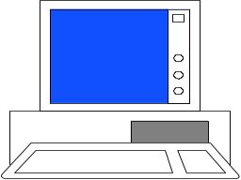
ERP with OLTP and OLAP Client Server using Data Warehouse
User Presentation Layer
First Tier
OLTP
Applications
OLTP
Server
OLAP
Server
OLAP
Applications
Second Tier
Application Layer
Operations
Database
Operations
Database
Server
Data
Warehouse
Third Tier
Data
Warehouse
Server
Database Layer

Slide 24
Data Warehouse Process: Stage 1
Modeling data for the data warehouse
  Because of the vast size of a data warehouse, the warehouse database consists of de-normalized data.
    Relational theory does not apply to a data warehousing system.
    Normalized tables pertaining to selected events may be consolidated into de-normalized tables.

Slide 25
Data Warehouse Process: Stage 2
Extracting data from operational databases
  The process of collecting data from operational databases, flat-files, archives, and external data sources.
  Snapshots vs. stabilized data
    A key feature of a data warehouse is that the data contained in it are in a non-volatile (stable) state.

Slide 26
Data Warehouse Process: Stage 3
Cleansing extracted data
  Involves filtering out or repairing invalid data prior to being stored in the warehouse
    Operational data are “dirty” for many reasons: clerical, data entry, computer program errors, misspelled names and blank fields.
  Also involves transforming data into standard business terms with standard data values

Slide 27
Data Warehouse Process: Stage 4
Transforming data into the warehouse model
  To improve efficiency, data are transformed into summary views before being loaded.
  Unlike operational views, which are virtual in nature with underlying base tables, data warehouse views are physical tables.
    OLAP permits users to construct virtual views.

Slide 28
Data Warehouse Process: Stage 5
Loading data into the data warehouse database
  Data warehouses must be created & maintained separately from the operational databases.
    internal efficiency
    integration of legacy systems
    consolidation of global data

Slide 29
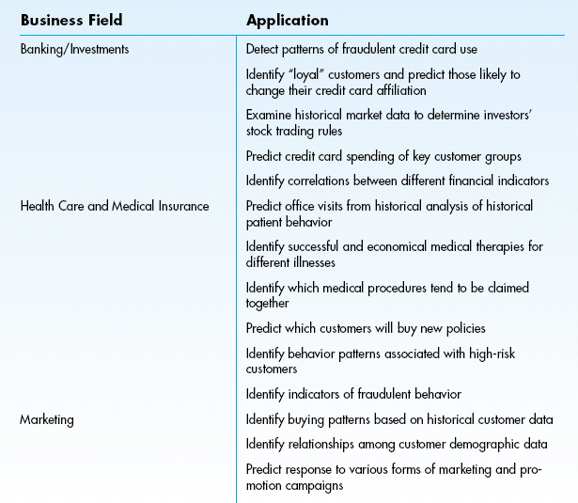
Applications of Data Mining

Slide 30
Risks Associated with ERP Implementation
Pace of implementation
  ‘Big Bang’--switch operations from legacy systems to ERP in a single event
  ‘Phased-In’--independent ERP units installed over time, assimilated, and integrated
Opposition to change
  user reluctance and inertia
  need of upper management support
Choosing the wrong ERP
  goodness of fit: no one ERP product is best for all industries
  scalability: system’s ability to grow

Slide 31
Risks Associated with ERP Implementation …
Choosing the wrong consultant
  common to use a third-party (the Big Four)
  thoroughly interview potential consultants
  establish explicit expectations
High cost and cost overruns
  common areas with high costs:
    training
    testing and integration
    database conversion
Disruptions to operations
  ERP implementations usually involve business process reengineering (BPR)
    expect major changes in business processes

